Slide 1

Loan Approval Forecasting using Machine Learning
Supervisor
Dr. A. MANIKANDAN M.E, Ph.D., Associate Professor Department of CSE VISTAS, Chennai
Thanigaivel G - 24880107
MTECH- CSE – I Year

Slide 2
Abstract
The financial industry is rapidly adopting automated decision-making systems powered by Machine Learning (ML).
This project focuses on predicting loan approval outcomes based on applicant data such as income, credit score, and employment history.
Historical loan application data was used to train predictive models using supervised machine learning algorithms like:
Logistic Regression
Decision Trees
Random Forest
Support Vector Machines (SVM)
Key steps included:
Data preprocessing (handling missing values, encoding categorical data).
Feature selection and model training.
Model evaluation using metrics: Accuracy, Precision, Recall, F1-Score, and ROC-AUC.
Cross-validation was used to ensure model reliability and prevent overfitting.
Random Forest and SVM showed the best performance for forecasting loan approval.
2

Slide 3
Problem Inferred
Traditional loan approval processes in financial institutions are often time-consuming, manual, and subject to human bias. These systems rely heavily on rigid, rule-based assessments that may not accurately reflect an applicant's creditworthiness, especially for those with limited or non-traditional credit histories.
Key problems identified include:
Manual Processing Delays: Loan applications often take days or weeks to process, causing customer dissatisfaction and operational inefficiency.
Inconsistent Decision-Making: Human evaluations can be subjective, leading to inconsistent and potentially unfair loan approvals or rejections.
Limited Use of Available Data: Conventional systems fail to leverage the full potential of applicant data, ignoring insights that could improve decision accuracy.

Slide 4
Objective
The primary objective of this project is to develop a machine learning-based system that can accurately predict the approval status of loan applications based on applicant data and historical records.
To analyze historical loan data and identify key features that influence loan approval decisions.
To build predictive models using machine learning algorithms such as Logistic Regression, Decision Trees, Support Vector Machine and Random Forests.
To automate the loan approval process, reducing manual intervention and increasing operational efficiency.
To improve the accuracy and fairness of loan decisions by minimizing human bias and inconsistency.

Slide 5
Scope of this Project
This project aims to develop a machine learning model that can accurately predict whether a loan application should be approved or rejected based on applicant data and historical loan records.
It focuses on identifying and analyzing key factors such as income, cibil score, loan amount, and employment status to determine loan eligibility.
The system will be trained using supervised learning algorithms to learn patterns from previously approved and rejected loan applications.
The project will involve rigorous preprocessing steps including data cleaning, handling missing values, and feature engineering for optimal model performance.
Multiple algorithms will be tested and compared to identify the most effective model for loan approval prediction.

Slide 6
Proposed Work Outline
The proposed system is an intelligent, machine learning-based loan approval forecasting solution designed to assist financial institutions in making fast, reliable, and data-driven lending decisions.
This system leverages historical loan application data and predictive modeling techniques to determine the likelihood of loan approval. By analyzing applicant features such as income, credit history, employment status, and loan amount, the system provides accurate and consistent eligibility predictions.
Key features of the proposed system include:
Automated Decision Making: The system predicts loan approval outcomes in real-time, significantly reducing manual workload and improving decision speed.
Scalable & Flexible Architecture: It is designed to handle large volumes of applications and adapt to changing financial regulations and market conditions.

Slide 7
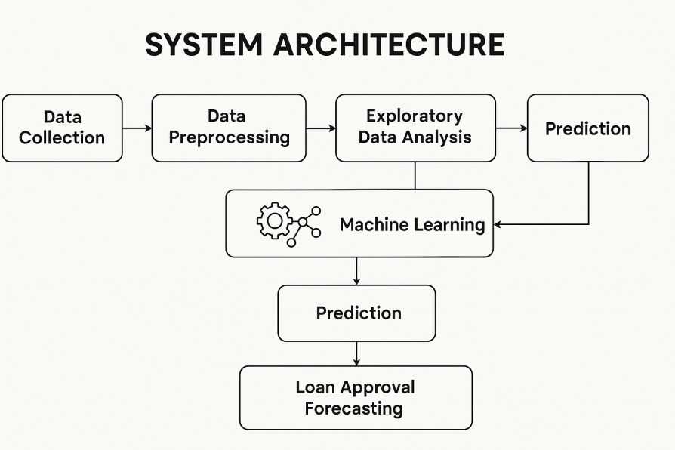
Block Diagram
7

Slide 8
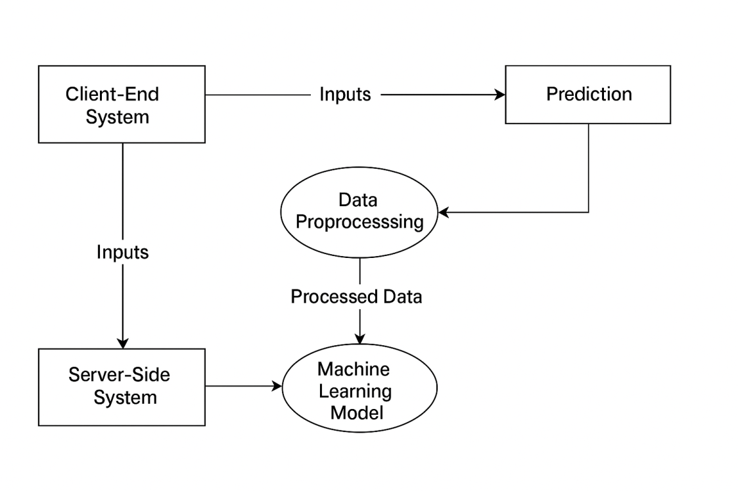
Overall Workflow Diagram

Slide 9
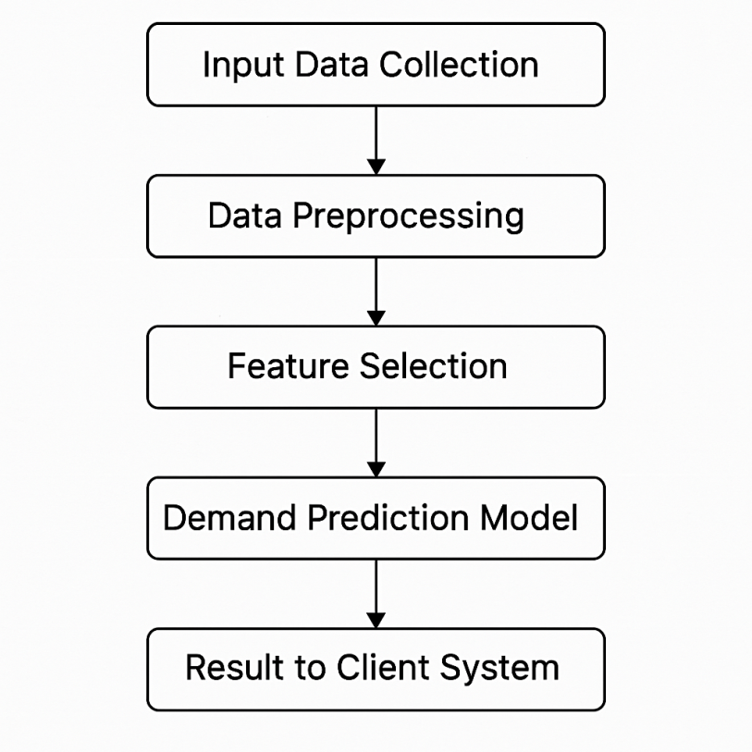
Module Flow Diagram

Slide 10
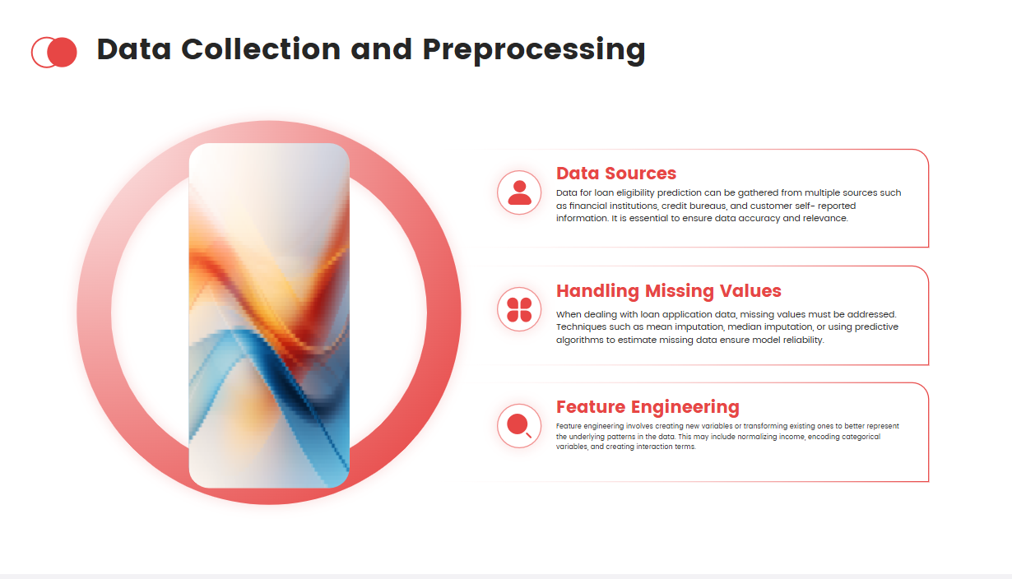


Slide 11
Feature Extraction
The process of identifying and selecting relevant attributes from raw data that can help the model make accurate predictions.
Converts real-world data into numerical inputs suitable for machine learning algorithms.
This helps in reducing noise and overfitting in the model creation.
Improves model accuracy and training speed.
Focuses the model on the most impactful variables.
Used Select K Best Method to extract the best Features.
Key Features Extracted
Age – Indicates the Age of the Loan Applicant.
Applicant Income – Indicates earning capacity.
Loan Amount – Determines the risk for the lender.
Cibil Score– Crucial indicator of creditworthiness.
Interest – Interest Percentage

Slide 12
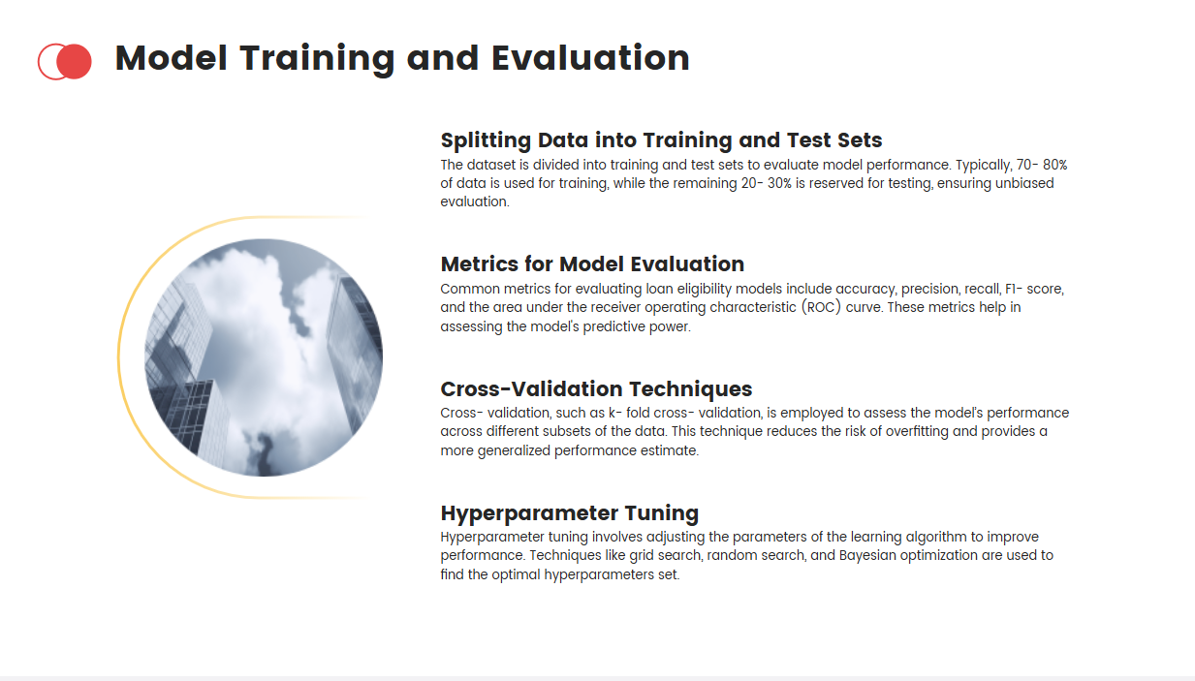
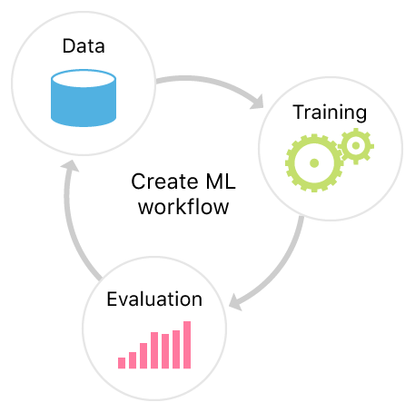

Slide 13

Minimum Hardware Requirements
Processor : Intel i3 or equivalent.
Storage : 256 GB HDD or SSD.
Monitor : 15 inch VGA Color.
Mouse : Logitech Mouse.
Ram : 4 GB
Keyboard : Standard Keyboard
GPU : Integrated GPU
Internet : Basic internet connection

Slide 14


Software Requirements
Python
Django (Web Framework)
Libraries Used
Scikit-learn
Pickle
Numpy
Pandas

Slide 15
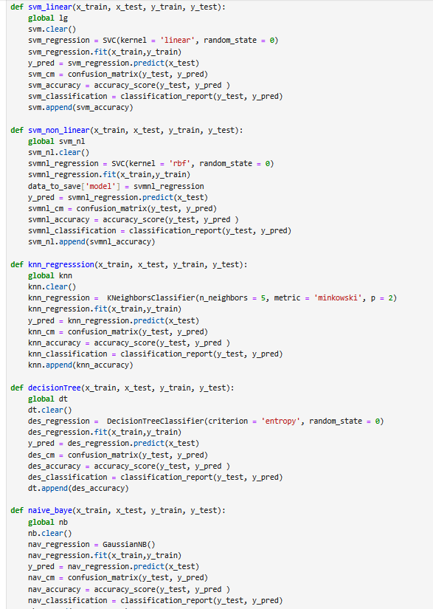
Algorithms

Slide 17
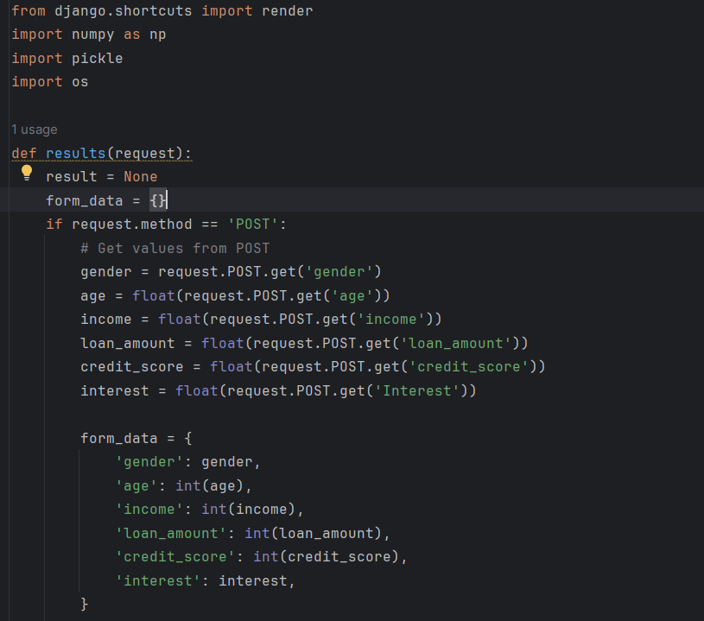
Deployment
(Django)

Slide 18
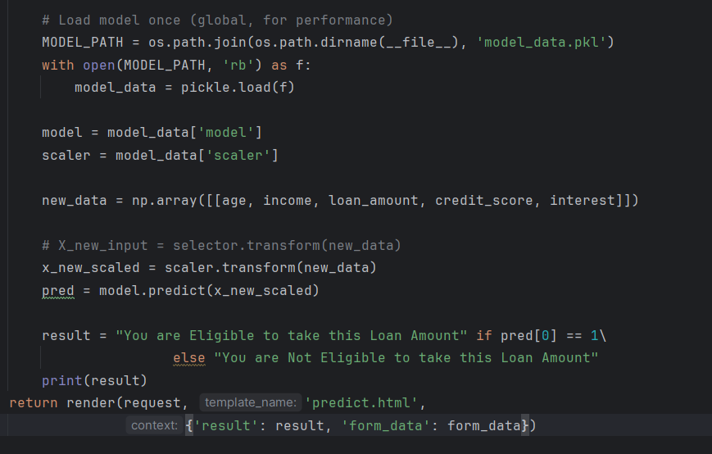

Slide 19
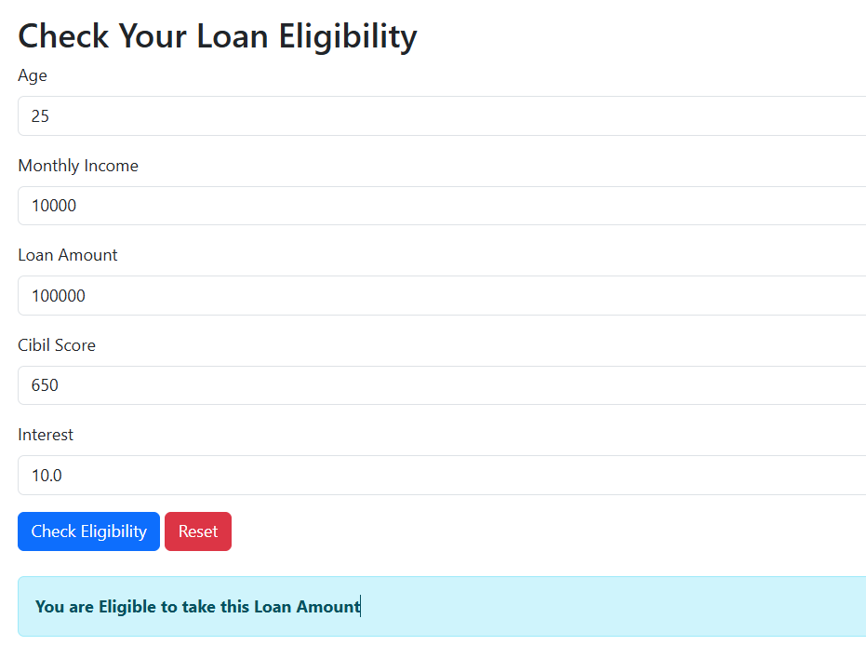
Output

Slide 20
Conclusion
The implementation of machine learning and data analysis in loan eligibility forecasting marks a transformative step in the modernization of the lending process. This project demonstrates how predictive modeling can significantly enhance the accuracy, speed, and fairness of loan eligibility assessments, enabling financial institutions to make more informed decisions with greater confidence.
By utilizing historical data and advanced classification algorithms, the system effectively evaluates applicant profiles, minimizes credit risk, and streamlines the loan approval workflow. This leads to improved efficiency, reduced human error, and better resource allocation—all critical components in today's fast-paced financial landscape.

Slide 21
Future Enhancement
Explore deep neural networks for more accurate predictions.
Include utility bill payments, rental history, and mobile financial transactions.
Improve credit evaluation for applicants with no formal credit history.
Develop systems that continuously learn and adapt to changes in data patterns and financial behavior.
Automate updates and model tuning for consistent performance.
Enhance user experience with faster approvals.

Slide 22
REFERENCES
Brown, I., & Mues, C. (2012). An experimental comparison of classification algorithms for imbalanced credit scoring data sets. Expert Systems with Applications, 39(3), 3446-3453.
Hand, D. J., & Henley, W. E. (1997). Statistical classification methods in consumer credit scoring: a review. Journal of the Royal Statistical Society: Series A (Statistics in Society), 160(3), 523–541.
Lessmann, S., Baesens, B., Seow, H.-V., & Thomas, L. C. (2015). Benchmarking state-of-the-art classification algorithms for credit scoring: An update of research. European Journal of Operational Research, 247(1), 124–136.
Khandani, A. E., Kim, A. J., & Lo, A. W. (2010). Consumer credit-risk models via machine-learning algorithms. Journal of Banking & Finance, 34(11), 2767–2787.
Thomas, L. C., Edelman, D. B., & Crook, J. N. (2002). Credit Scoring and Its Applications. SIAM.
Zhou, L., & Wang, L. (2012). Credit scoring with a data mining approach based on support vector machines. Expert Systems with Applications, 39(3), 3441–3445.
Baesens, B., Setiono, R., Mues, C., & Vanthienen, J. (2003). Using neural network rule extraction and decision tables for credit-risk evaluation. Management Science, 49(3), 312–329.
Martens, D., Baesens, B., Van Gestel, T., & Vanthienen, J. (2007). Comprehensible credit scoring models using rule extraction from support vector machines. European Journal of Operational Research, 183(3), 1466–1476.

Slide 23

THANK YOU
Dr. A. Manikandan (Supervisor)
Mrs. R. Kalpana (Supervisor)

